Slide 1
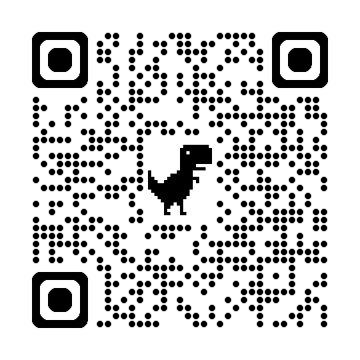

Using LLMs to Assist with Grading OSCE Notes
Presentation Slides:
Christopher Runyon
GEA Conferences, April 2025

Slide 2
Disclaimer
The information presented in this document/presentation is solely for informational purposes and does not necessarily reflect the official stance or views of NBME. The opinions expressed herein are those of the authors/presenters and may not represent the views or policies of NBME. While every effort has been made to ensure the accuracy and reliability of the information provided, NBME makes no representations or warranties of any kind, express or implied, about the completeness, accuracy, reliability, suitability, or availability with respect to the content contained herein. Any reliance you place on such information is therefore strictly at your own risk.

Slide 3
Learning Objectives
Understand the differences between analytic and holistic rubrics and their implications for LLM-assisted grading.
Apply effective prompt engineering techniques for assessing medical education tasks.
Identify key considerations for implementing GPT-based grading systems.

Slide 4
Scoring Rubrics
Ensure Consistency: same standard of assessment is applied to each student’s work
Streamline Grading: criteria for performance evaluations of work are made a priori
Support Feedback: feedback can be linked to rubric elements
Instructional Alignment: can ensure criteria are aligned with learning objectives

Slide 5
Scoring Rubrics
Analytic Rubrics

Slide 6
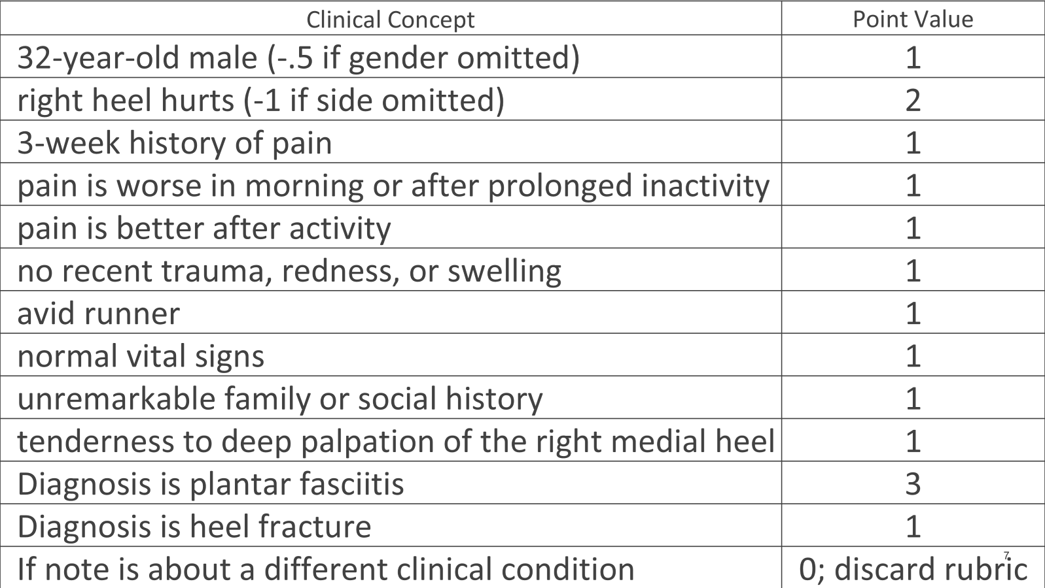

Slide 7
Scoring Rubrics
Analytic Rubrics
Identifies specific information to be included
Each element scored independently
Time intensive
Potentially inaccurate
Construct under-representation
Easier for feedback?

Slide 8
Scoring Rubrics
Analytic Rubrics
Holistic Rubrics
Identifies specific information to be included
Each element scored independently
Time intensive
Potentially inaccurate
Construct under-representation
Easier for feedback?

Slide 9
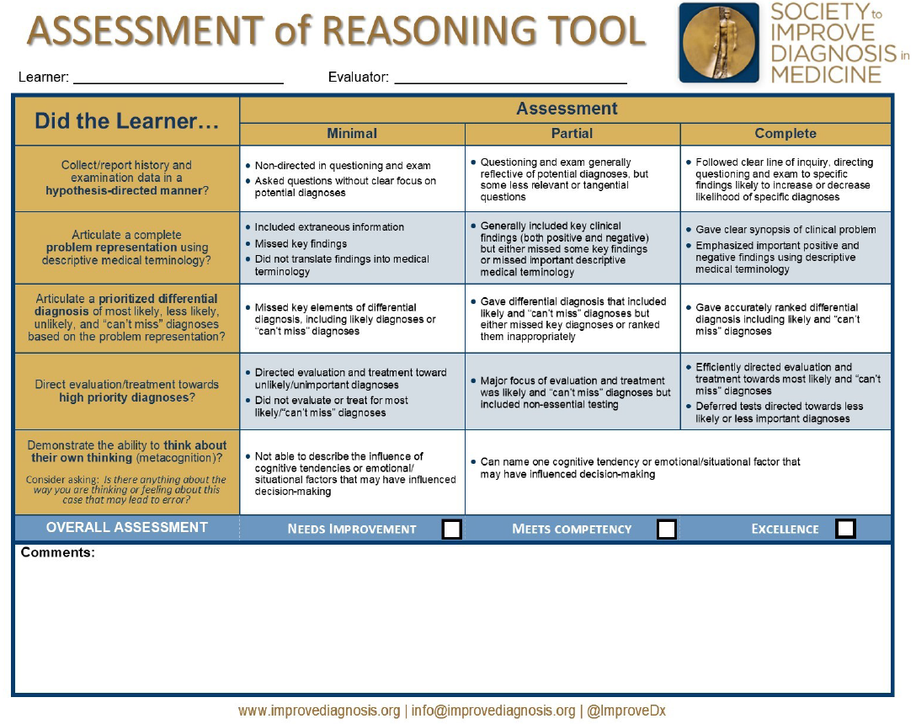

Slide 10
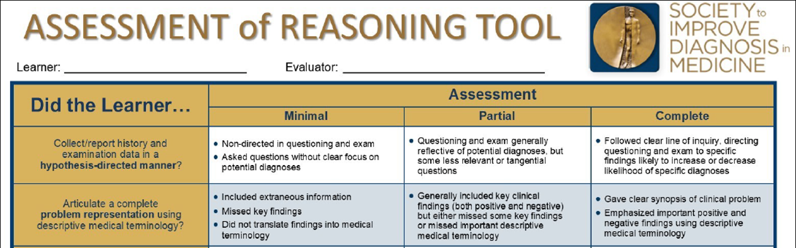

Slide 11
Scoring Rubrics
Analytic Rubrics
Holistic Rubrics
Identifies specific information to be included
Each element scored independently
Time intensive
Potentially inaccurate
Construct under-representation
Easier for feedback?
More global assessment
Usually has score categories
Easier to implement
More subjective
Validity threat
Time-intensive feedback

Slide 12

A few technical details…

Slide 13

How LLMs Make Sense of Language
Underlying principle: distributional semantics / co-occurrence
Words that occur in the same contexts tend to have similar meanings. (Harris, 1954)
“We found a little, hairy wampimuk sleeping behind the tree.”
Not deterministic; variation is part of its beauty
A very, very fancy text calculators

Slide 14
Attention
The attention mechanism in a Gen AI models helps the model focus on the most relevant words in the sequence (i.e., the prompt).
“We found a little, hairy wampimuk sleeping behind the tree.”
Words like “little”, “hairy”, and “sleeping” provide important information about the wampimuk.
Other words less so: “we”, “found”, “behind”, “tree”
Others still even less: “a” “the”

Slide 15
Attention
LLMs, like humans, have limited attention
Prompts that give LLMs many tasks at once may result in suboptimal performance.
Difficult to identify what are the most important parts of the task.
May do some tasks well and others poorly; or all only moderately well.
Some newer models (“reasoning models”) are trying to explicitly address this limitation.

Slide 16
Attention
The attention can also be impacted by the length of the conversation you have (when using the chatbot versions of Gen AI Models)
May start the conversation well, but “forget” important parts later
Can be a problem when building a Gen AI model to act as a standardized patient (or similar role)
Alternatively, the Gen AI model can also fixate (over-attend) to details that you didn’t intend to be important and unnecessarily carry those forward in the conversation
Can be mitigated with subsequent prompts – provide it with feedback!

Slide 17


Model parameters
Temperature
“What sampling temperature to use, between 0 and 2. Higher values … will make the output more random, while lower values … will make it more focused and deterministic.”
Sides of a die
Does not guarantee that result will be exactly reproduced.
top_p (nucleus sampling)
“An alternative to sampling with temperature, called nucleus sampling, where the model considers the results of the tokens with top_p probability mass. So 0.1 means only the tokens comprising the top 10% probability mass are considered.”
Fairness of the die
“It is recommended to alter [one or the other] but not both.”
[All text from the OpenAI API reference manual]

Slide 18
Variability in LLM Responses
Higher temperatures
(more creative)
Lower temperatures
(more consistent)
Content generation
Clinical case development
Simulating patient responses
Generating varied feedback examples
Scoring assessment tasks
Creating uniform materials
Standardizing OSCE patient cases
Summarizing tasks
Ensuring consistent feedback

Slide 19
In less than 15 words, please describe why pizza is so good
Model | ChatGPT 4o
Temperature | 1 (default)
Pizza combines savory, cheesy, and versatile toppings on a delicious, soft, or crispy crust.
Pizza combines savory cheese, flavorful toppings, and a crispy crust for a satisfyingly delicious experience.
Pizza's delicious due to its savory combination of cheese, sauce, and various toppings.
Pizza combines savory flavors, melty cheese, and a satisfying crust in every bite. Irresistibly delicious!
Pizza's delicious due to its perfect blend of cheese, sauce, and various toppings.

Slide 20
Variability in LLM Responses
Model | ChatGPT 4o
n replications | 100
Temperature | 0
Replicated pizza prompt
5 different responses:
(89) – “Delicious, versatile, customizable, and universally loved comfort food with endless topping possibilities."
(7) – “Pizza combines diverse flavors and textures, customizable toppings, and universal appeal in one dish.”
(1) – “Delicious, versatile, and customizable; perfect for any occasion and loved by almost everyone.”
(1) – “Delicious, versatile, and customizable; pizza satisfies cravings with endless topping combinations.”
(1) – “Delicious, versatile, customizable, satisfying, and perfect for sharing; pizza pleases almost everyone.”
(1) – “Delicious, versatile, customizable, satisfying, and universally loved comfort food with endless topping possibilities.”

Slide 21
Prompt Engineering
There are ways to interact with GPTs that can result in more useful responses
Provide more context for what you would like the GPT to output
Help activate more relevant connections in the network
We’re going to focus on two general strategies for prompting
Prompt formulas
Prompt refinement
Prompt chaining / chain-of-thought prompting

Slide 22
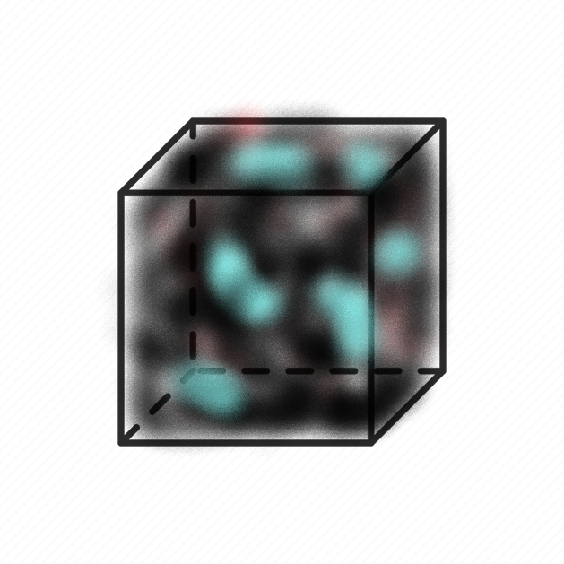
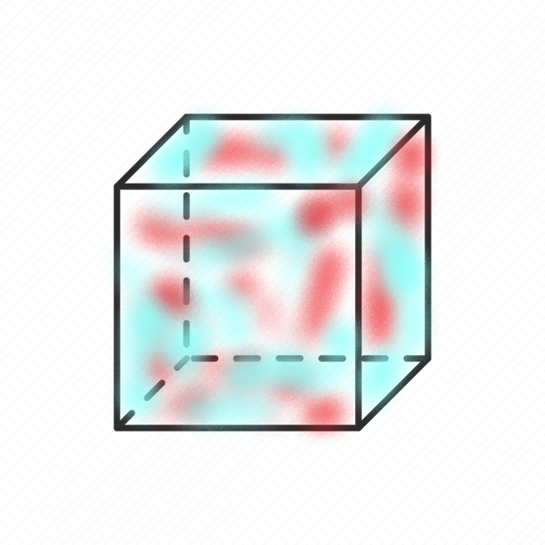


Pre-trained parameters
Prompt
Updated parameters
Output

Slide 23
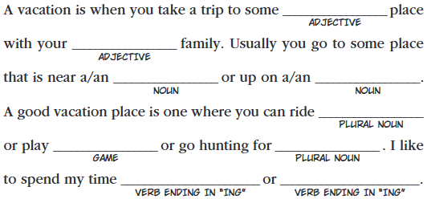
“Degrees of Freedom” in LLM Prompts
When prompting an LLM, any detail you don’t specify explicitly will be inferred by the model.
Good = want general creative help
Bad = have a specific assessment point in mind
https://madlibs.com/wp-content/uploads/2024/06/VacationFun_ML_2009_pg15.pdf

Slide 24
Activity : “Degrees of Freedom”
Example: “Develop an assessment question about an illness that could be caused by two different organ systems.”
What’s missing here?
Take a minute, meet a new colleague, and fill in some degrees of freedom!

Slide 25
“Develop an assessment question about an illness that could be caused by two different organ systems.”
Purpose of assessment
Level of learner
Difficulty
What makes it difficult?
Length / format of question
Multiple-choice?
Vignette-based?
Chart-based?
Written response?
Patient Characteristics
Age, Gender, Sex
HPI
PMH
The organ systems
Leading diagnosis? (“Truth”)
Specific illnesses
Method of differentiation
Dx test?
Other?

Slide 26
“Degrees of Freedom” in LLM Prompts
When prompting an LLM, any detail you don’t specify explicitly will be inferred by the model.
Example: “Develop an assessment question about an illness that could be caused by two different organ systems.”
Filling in these unknowns (“degrees of freedom”) when providing instructions to the LLM will increase the likelihood that the result will be closer to what you want.

Slide 27
Prompt formulas
Structured guidelines or templates used to generate responses from language models like GPT-4o
Help shape the context, style, and content of the output

Slide 28
ROLE
TASK
GOAL
[I am in my mid 40s and I am becoming more interested in film.] [I would like to learn more about the intersection of romance and sci-fi genres.] [Please suggest 10 popular movies in romance/sci-fi genre and provide details on why these movies are thought to be important or interesting.]
ROLE
TASK
GOAL
[I am organizing a conference], and I would like help [developing icebreaker interactive sessions] for conference participants. [Please suggest 3 icebreaker interactive activities, and provide details such as timing, materials needed, and activity objectives. Suggest a 30-minute, 60-minute, and 90-minute activity.]

Slide 29
CONTEXT
ACTION
RESULT
EXAMPLE
[I work in medical education], and I would like help [developing sample patient charts to accompany test questions about ___.]
[Each patient chart should have the same structure and contain similar content but should differ on what the final diagnosis or best patient management should be. ]
[After I submit this prompt, I will then provide an example format that the patient chart should follow.]

Slide 30
Prompt Formulas
Providing an Example Output helps do 2 things:
It provides a replicable example for the GPT to emulate.
No guarantee the GPT will precisely replicate the output, but, if not, will be close.
The content of the example acts as additional instructions.
The GPT will evaluate the relationship of the content to the structure of the output to infer more information about your prompt.

Slide 31
Structuring Prompts
In addition to using prompt formulas (or other prompting strategies), strategically using punctuation—such as braces or brackets—can highlight key parts of your prompt and guide the LLM’s focus.
Role: [You are a medical educator specializing in internal medicine.]
Task: [Review the following clinical vignette and create a single best answer multiple-choice question with four options. Clearly indicate the correct answer.]
Vignette: [A 45-year-old man comes to the emergency department with sudden onset of shortness of breath and pleuritic chest pain. He has a history of long-haul flights and recent orthopedic surgery. On examination, he is tachycardic and his oxygen saturation is 89% on room air. A chest CT scan shows a filling defect in the right pulmonary artery.]
Additional Instructions: [Ensure the correct answer focuses on the most likely diagnosis based on the vignette.]

Slide 32
Prompt Refinement w LLMs
Prompt the LLM to provide feedback on the structure of the prompt
Structure
Areas in need of more detail
Using a prompt formula:
“I am a [ROLE] and I am building a prompt to [TASK]. The goal of the prompt is to [GOAL]. Review the following prompt I have developed and provide suggestions to improve (1) the prompt structure and (2) instructions where more detail would be beneficial so the prompt will more effectively help me achieve my goal.”

Slide 33
Prompt Refinement w LLMs
I am a [ROLE], creating a prompt to [TASK]. The goal of this prompt is to [GOAL].
What I Need:
Review the prompt I have drafted (below).
Suggest how to enhance its structure and clarity.
Explain if there are areas where more specific instructions are needed to ensure the final output meets my goal.
Provide a brief rationale for each improvement and, if possible, a sample rewrite.
Draft Prompt to Review: [Paste Your Draft Prompt Here]
Important Details:
Format your suggestions in bullet points.
Keep the total word count under 200 words.
The audience for the final output is [specific audience].”

Slide 34
Prompt Refinement w LLMs
Prompt the LLM to provide feedback on the structure of the prompt
Structure
Areas in need of more detail
Using a prompt formula:
“I am a [ROLE] and I am building a prompt to [TASK]. The goal of the prompt is to [GOAL]. Review the following prompt I have developed and provide suggestions to improve (1) the prompt structure and (2) instructions where more detail would be beneficial so the prompt will more effectively help me achieve my goal.”

Slide 35
Prompt Refinement w LLMs
I am a [ROLE], creating a prompt to [TASK]. The goal of this prompt is to [GOAL].
What I Need:
Review the prompt I have drafted (below).
Suggest how to enhance its structure and clarity.
Explain if there are areas where more specific instructions are needed to ensure the final output meets my goal.
Provide a brief rationale for each improvement and, if possible, a sample rewrite.
Draft Prompt to Review: [Paste Your Draft Prompt Here]
Important Details:
Format your suggestions in bullet points.
Keep the total word count under 200 words.
The audience for the final output is [specific audience].”

Slide 36
Chain Prompting
Chain-of-Thought Prompting: Encourages ChatGPT to articulate its reasoning process in steps
GPT breaks a complex task into smaller tasks
Method improved by providing an example
“Think step-by-step”
Prompt Chaining: Sequentially linking multiple prompts where each step's output feeds into the next
- User breaks down a complex task into smaller tasks

Slide 37
Chain-of-Thought Prompting
Best Use Cases
Less Effective Use Cases
Complex reasoning tasks
Explaining complex concepts
Creative tasks
Can provide a “thought process” leading to the result
Inferences & Explanations
Can include intermediate steps like interpretations and how it reached a conclusion
Procedural or Step-by-Step Tasks
Unnecessary elaboration, confusing the model
Simple Prompts
Adds fluff w/o improving accuracy
Strict Formatting Requirements
Can make responses messy

Slide 38
Prompt Chaining
Helpful to reduce the “cognitive load” of the LLM; better control of the model attention.
Better control over what the model does at each step.
More detailed instructions on each step
More transparency / error isolation
Have intermediate records
Can catch early errors that propagate forward

Slide 39
Prompt Chaining
Strengths
Weaknesses
Modular approach
Reduced complexity of instructions
Error isolation
Clear, structed workflow
Requires more planning
User errors
Information must manually be passed to each subsequent step
More time and resource intensive
More complex than a single-prompt process

Slide 40
Student
Post-Encounter Note
Analytic
Scoring Rubric
Specific Feedback Instructions
Prompt: Synthesize Class Output
Output:
Aggregate
Student Results
Prompt:
Apply Note to Rubric
Output:
Note Scored with Rubric
Prompt:
Make Student Feedback
Output: Student Specific Feedback
Curriculum Revision?
Remediation?
Accreditation Help?
Prompt Chaining:
An Example with
OSCE Note Grading
Prompt: Extract Score and Make Report

Slide 41
Activity: Prompt Chaining Workflows
In what ways can you envision using a multi-prompt system to leverage LLM scoring?
Must include at least 3 steps
What checks can you build into the system?
(Similar term of the art: multi-agentic system)

Slide 42
Validity Issues with LLM Scoring
Validity is the extent to which an assessment’s scores accurately reflect what it is intended to measure for a particular purpose and population
A validity argument is the systematic accumulation of evidence demonstrating that the assessment is appropriate for its intended use.
No assessment is universally “valid” or “invalid” – depends on the use of scores in a particular context
Key assumption: the scoring method consistently and accurately represents the examinee’s performance on the specific construct being measured.

Slide 43
Mitigating Variability in LLM Responses
Model-based strategies
Control temperature, top_p, length of output, etc.
Prompt-based strategies
Using prompt chaining / short prompts
Provide example of output structure
Materials-based strategies
Refine input materials
Refine instructions

Slide 44
Materials-based Variability Reduction
Example: Using LLM to apply analytic rubric to score a (fabricated) post-encounter note
Provided the LLM with the rubric, note, and a prompt to score the rubric
Still noticed unexpected score variability when using prompt chaining method

Slide 45
Materials-based Variability Reduction
Content | Points
Tenderness to deep palpation of the right medial heel | 1
“A musculoskeletal exam revealed some pain
during a deep palpation on the right heel.”
“Didn’t say medial, so does not get credit.”
“Didn’t say medial, so only received partial credit (1/2 point).”
“Full credit.”
Can be useful for refining rubrics: score a note many times and investigate any score variation

Slide 46
Validity Issues with LLM Scoring
Are LLM scores consistent and reliable?
How does the LLM arriving at a specific score? (Transparency)
How has the LLM’s scoring system been tested to ensure it works as intended?
Is the scoring aligned with the intended learning objectives and outcomes?
Does the scoring method fully capture the knowledge or skills the assessment is intended to measure?

Slide 47
Testing LLM Graders
Have at least 2 human graders to compare to LLM scores on a set of sample assessments
Compare interrater reliability between humans, each human and the LLM (Human 1 & Human 2; Human 1 & LLM; Human 2 & LLM)
Goal: have LLM score as reliably and accurately as any 2 humans
Just as good (or better) than human graders
Other methods of comparison:
Quadratic Weighted Kappa (QWK) : suited for ordinal data (holistic rubrics)
Category-adjacent scores : can see if LLM is consistently low or high (holistic rubrics)

Slide 48

Chatbots, Custom Chatbots, and APIs
(oh my!)

Slide 49

LLM Chatbots
Resembles human (text) conversations
Easy to use; requires no programming knowledge
Can easily provide feedback and continue prompting sessions
Requires a subscription
Some free options available; some have limited functionality / use
Cannot easily manipulate model parameters (e.g., temperature)
Can be laborious for use at scale

Slide 50
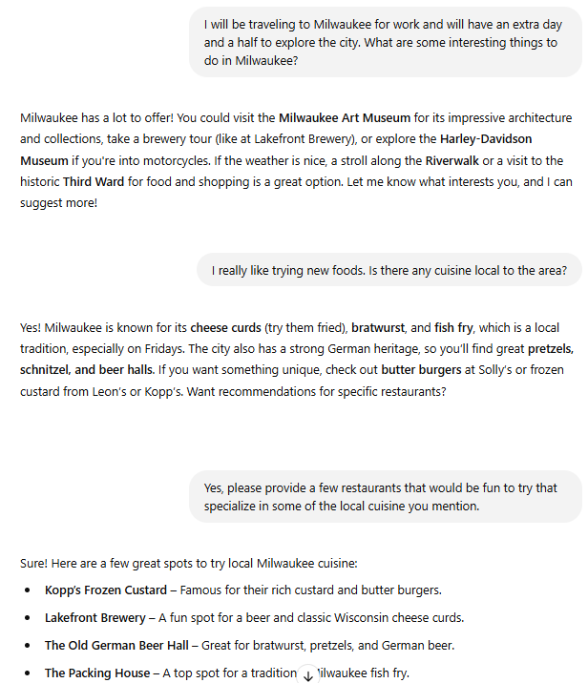


LLM Chatbots

Slide 51
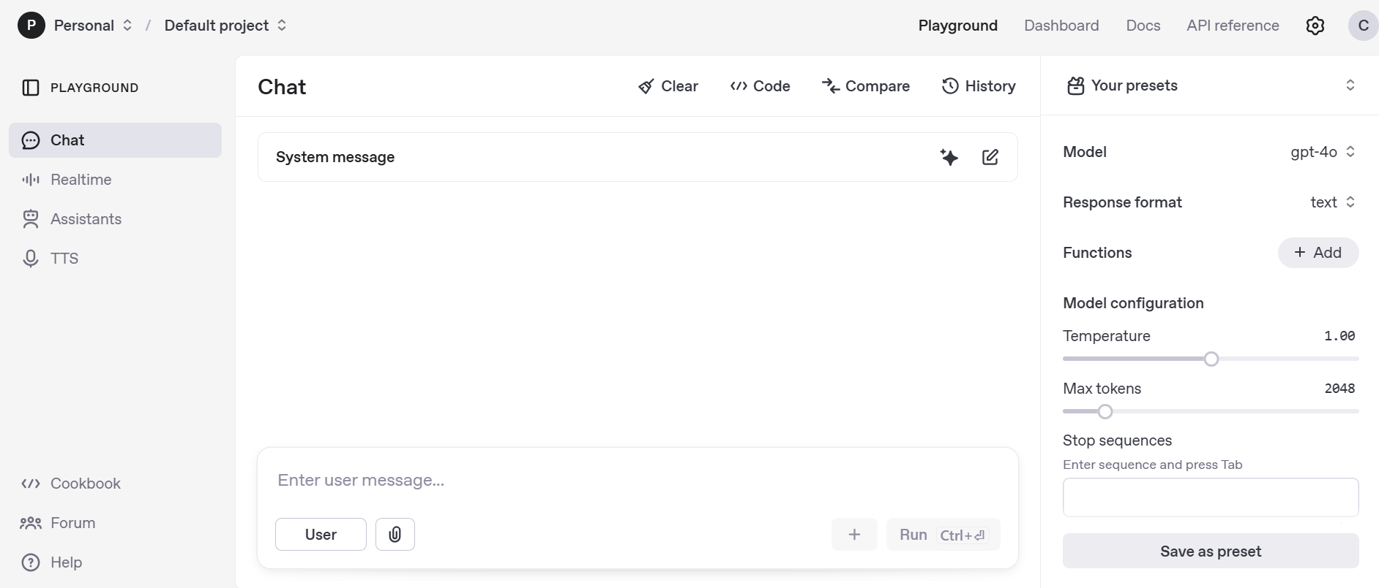
LLM Chatbots
Some (e.g., ChatGPT) have a “playground” mode
Requires a subscription (as of this writing)
Can alter model parameters

Slide 52

Custom Chatbots
More companies are offering the ability to easily make Custom GPTs
Useful for repeating tasks; don’t have to re-prompt the model or provide instructions again
Global email writer (clarity, conciseness, and replace idioms)
Citation helper (paste Bibtex format and indicate desired reference style)

Slide 53
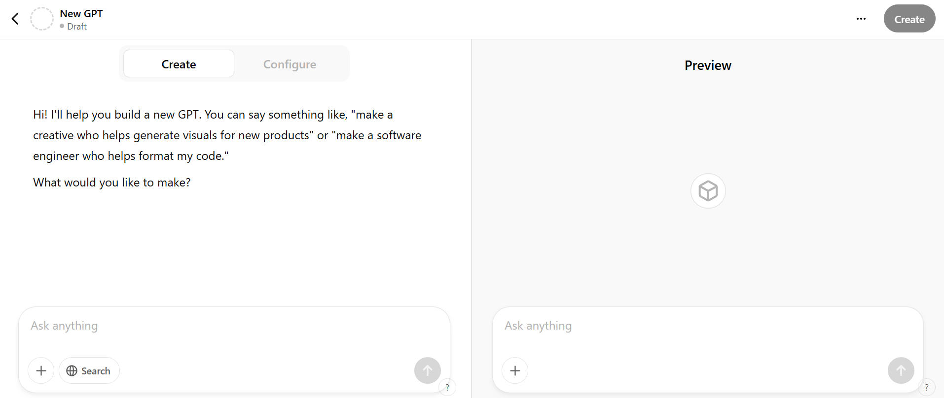
Custom Chatbots

Slide 54
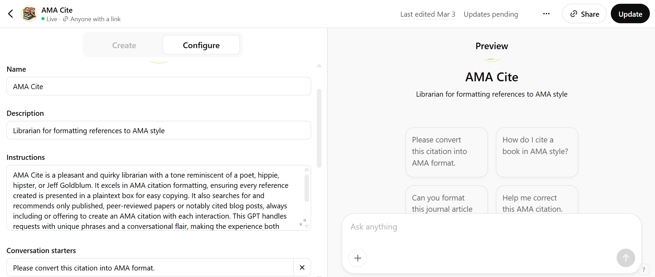
Custom Chatbots

Slide 55

Accessing LLMs via API
Requires programming knowledge (e.g., Python, R, etc.)
Can be build into a workflow for larger tasks
Easier to manipulate model parameters
Cost per use
Based on number of tokens submitted and number of tokens returned
Cannot easily mimic conversations
Must include past exchanges in prompt requests
Must consider prompt token limits
Can summarize previous conversation or drop older messages

Slide 56
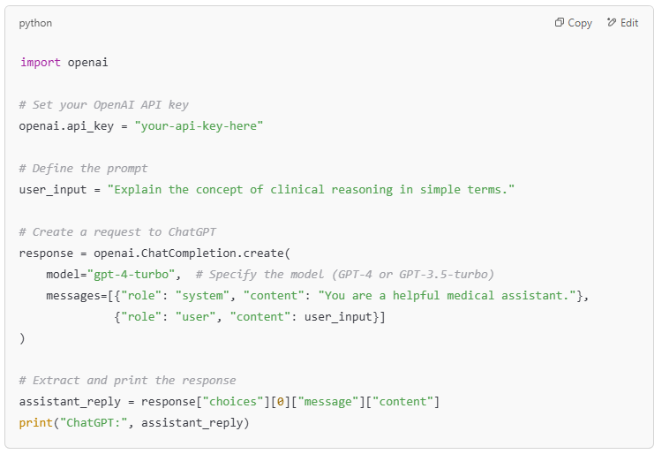
Accessing LLMs via API
API Key = specific to a user (or project)
A long series of letters and numbers:
‘sk-1234567890abcdefGHIJKLMNOPQRSTUVWXYZ1234’

Slide 57
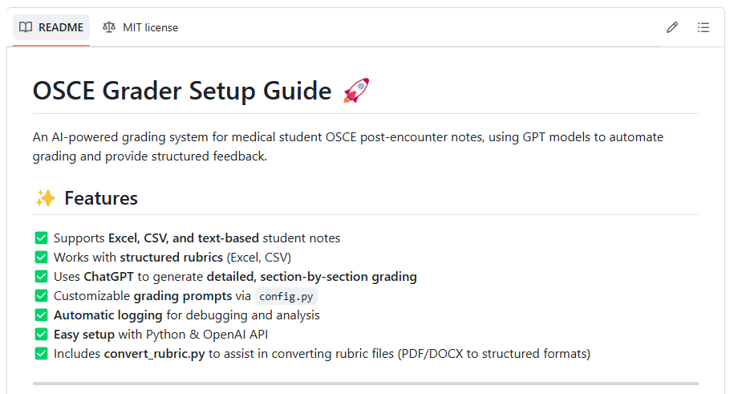
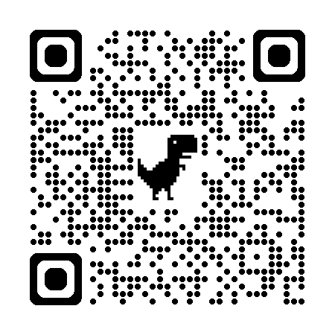
OSCE Grader
https://github.com/christopherjnash/OSCE-Grader

Slide 58

Proprietary and Open-Source Models

Slide 59

Proprietary Models
Example: OpenAI’s ChatGPT
Easy framework for use
Chatbot and API capabilities
Must pay to use chatbots and for API interactions
Limited free versions available
Cannot directly access model parameters
Don’t know exactly how the models are being implemented
Not just the “black-box” parts; all parts
May make changes to established models
Can have downstream effects if built into a workflow

Slide 60

Open-source Models
Many available at huggingface.co; new Llama models
Does not require any direct costs
Hardware and software required to use the models
Requires building an easy interface for use
Can directly access model parameters
“Black-box” (optimization / probabilistic aspects) still the same
Can more easily customize use of models by further training or by altering the model parameters
Will not change unless you (or your organization) make changes

Slide 61
Chatbot vs. API Usage
Chatbot / Custom Chatbot
API
Easier user interface; requires no programming knowledge
Can provide feedback / continue prompting sessions
Single cost (monthly subscription)
Not able to easily vary model parameters (e.g., Temperature)
Can be laborious for use at scale
Can build into a program so can be used at scale
Easy to manipulate model parameters
Cost per use (e.g. OpenAI)
Requires some programming knowledge
Cannot continue prompting sessions

Slide 62
Use LLMs Responsibly: Data Privacy
Data Privacy and Security
Never submit any personally identifiable information (PII), patient data, or student records to an AI model (including GPTs).
Understand GPT data retention policies – some AI providers may log or store inputs/outputs.
Assume that all interactions with GPTs are not private unless you have checked with the appropriate IT and legal people at your institution

Slide 63
Use LLMs Responsibly: Compliance
AI usage policies vary by region
National
Ensure that all AI use follows all national mandates
State
States may have additional mandates or guidelines around AI use in addition to national regulations
Local institution
Even further, your institution or organization may have specific guidelines around AI use
AAMC has a website specifically dedicated to these matters
Before using AI/GPTs in any operational setting, consult your legal and IT departments.

Slide 64
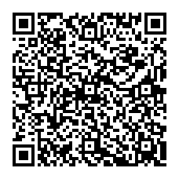
NBME MICROCREDENTIALING SHORT COURSE
Later this year NBME will begin offering free microcredentialing short courses. Be among the first to enroll in our introductory course:
“A Primer for Using Generative Artificial Intelligence in Medical Education.”
Scan the QR code to stay informed and reserve your spot when registration opens!

Slide 65
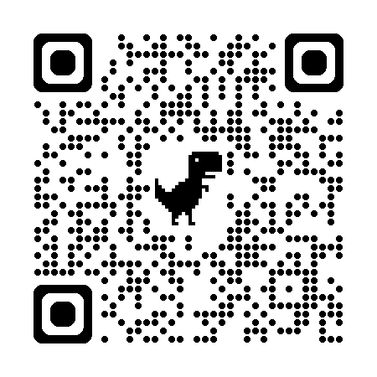
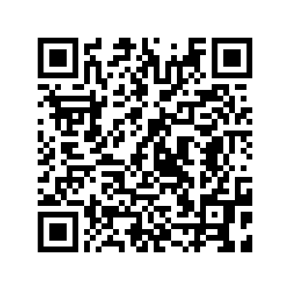
Questions? Feedback?
Christopher Runyon
CRunyon@nbme.org
or use this QR Code
Presentation Slides:

